Slide 1


Slide 2
Consumer Benefits of FinTech
Fintech is the term which was used to mean innovations in the field of financial and technology worldwide, also this term can refer to mean those companies or services that are devoted in using technology for their financial products for the growth of the business or the consumer

Slide 3
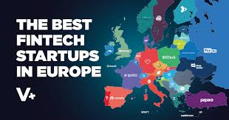

Slide 4
Benefits of FinTech
Create convenience
Increases personalized service
Enhanced security

Slide 5
Benefits of FinTech
Lower costs
Faster ate of approval
In conclusion, FinTech companies use various technologies to make financial services easily as compared with the absence of it. These types of companies are purposeful to disrupt obligated financial systems that are usefully incorporated to dwell on the use of the software.

Slide 6
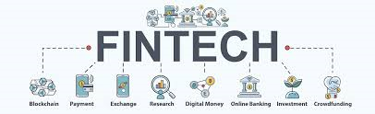

Slide 7
Uses and examples of FinTech
Crowdfunding platforms; this help or allow the internet or app users to send and receive money from one person to another through the internet. At the same time, it allows individuals to get fund from different sources.

Slide 8
Uses and examples of FinTech
Blockchain and Cryptocurrency; blockchain services help to reduce fraud through keeping provenance data on the blockchain while cryptocurrency exchanges like coinbase and Gemini help to connect customers to buy or sell products.

Slide 9
Uses and examples of FinTech
Budgeting Apps; the budging app is one way of the uses of fintech in this era by the consumers that have been rapidly grown because of its high demand.
Robo-Advising and stock-trading apps

Slide 10
References
Chang, Y., Wong, S. F., Lee, H., & Jeong, S. P. (2016, August). What motivates Chinese consumers to adopt FinTech services: a regulatory focus theory. In Proceedings of the 18th annual international conference on electronic commerce: e-commerce in a smart connected world (p. 40). ACM.

Slide 11
References
Huei, C. T., Cheng, L. S., Seong, L. C., Khin, A. A., & Bin, R. L. L. (2018). Preliminary Study on consumer attitude towards FinTech products and services in Malaysia. International Journal of Engineering & Technology, 7(2.29), 166-169.
https://www.youtube.com/watch?v=-EoNrg_DR3s

